Slide 1
Slaying the Fear of the Dragon: Personal Learning Strategies
Presented by
Karin Lee
klee@sanjacinto.k12.ca.us
Dr. Jordan Smith
jsmith@sanjacinto.k12.ca.us
San Jacinto Unified –
Mountain View High School

Slide 2
Notes:
We introduce ourselves and show this clip

Slide 3
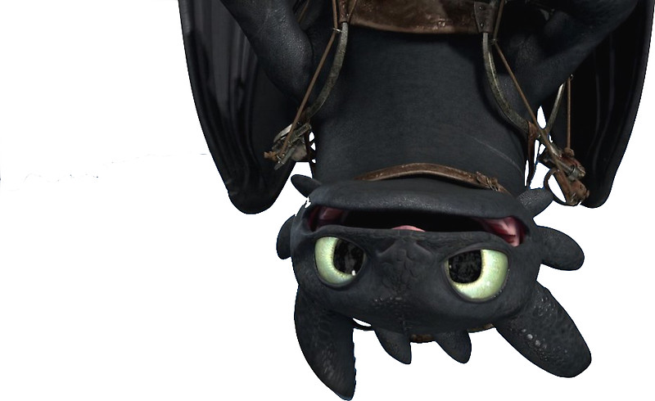
As we stated in our synopsis
our goal this year has been to
“slay” the data-driven approach to
education and to create equity and empowerment for our students.
We found that for us to do that we
ourselves had to readjust our own strategies
and belief systems.
While there still needs to be “assessment” it doesn’t necessarily mean TEST!
Notes:
How many of you have to teach to the test?
How many spend a LARGE portion of your department meeting just dealing with assessment data?

Slide 4
What we found was that many of our students, especially the 11th and 12th graders who come to us with ZERO math credits completed; also have BIG gaps in knowledge, based on their scores on the 6-8 diagnostic we give and observation.
These are the students who could be considered the lost generation. They were in 6-9th grade and were not taught using the Common Core standards, processes or curricula; they are a product of the system change.
Basically we throw them into this vastly different pattern of learning with out a back-up plan: and lets be real, even as teachers this CC system can be quite an obstacle to overcome.
Notes:
Does anyone in here also have that issue, while we are an alternative school, I am sure that at every 9-12 site this is an issue.

Slide 5
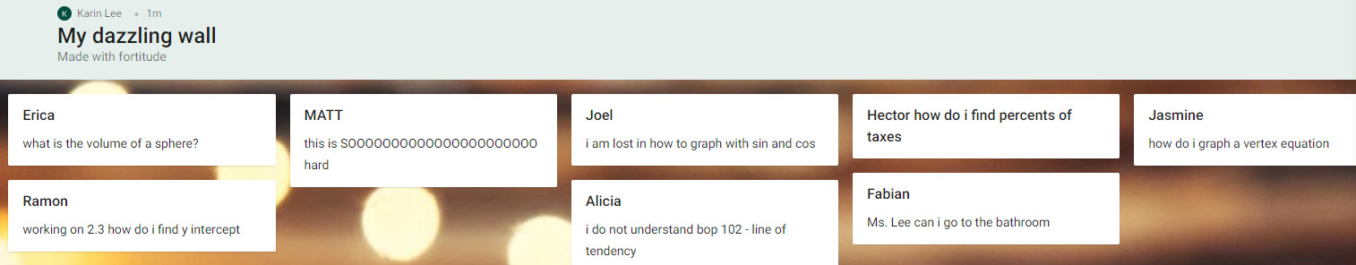
Padlet
goo.gl/eSkF2j
For a while we used Padlet as a way for students to communicate
with us if they needed help or …
But we found as the year progressed the process was a bit cumbersome
and those who were with us all year began to be silly!
We also then added other technology pieces and there is only so
much you can monitor while teaching.
Notes:
Jo Boaler
Teacher mindset – mindsetworks.com – have them take maybe?
Myself
My environment

Slide 6
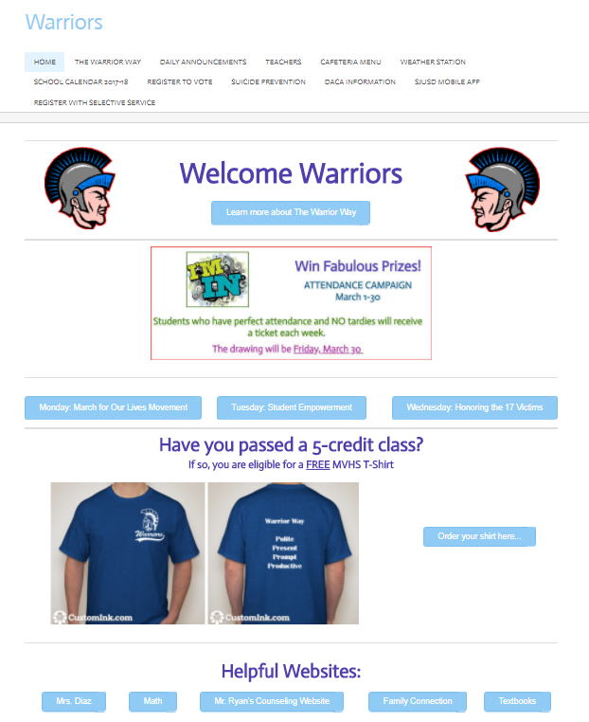
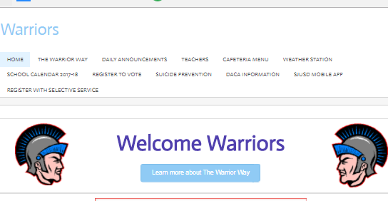
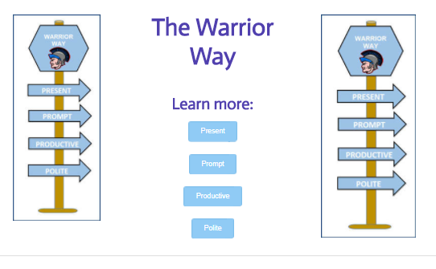
The Orientation
Page
So we created an Orientation Page link on our Welcome Warriors webpage.
WW is a school wide webpage that every student is introduced to on their first day and it contains, as you can see; many informational buttons and web pages for the students. As we have many entering adulthood we have voting registration, selective service, DACA, FAFSA, etc available for them to get info from.
If they click on the math button they
go to our webpage

Slide 7
We have the students take a variety of surveys and diagnostic assessments that show us and them their ability level and their mindset; all found under the orientation heading
https://warriorcchsmath.weebly.com/orientation.html
https://warriorcchsmath.weebly.com/orientation.html
Notes:
https://warriorcchsmath.weebly.com/orientation.html

Slide 8
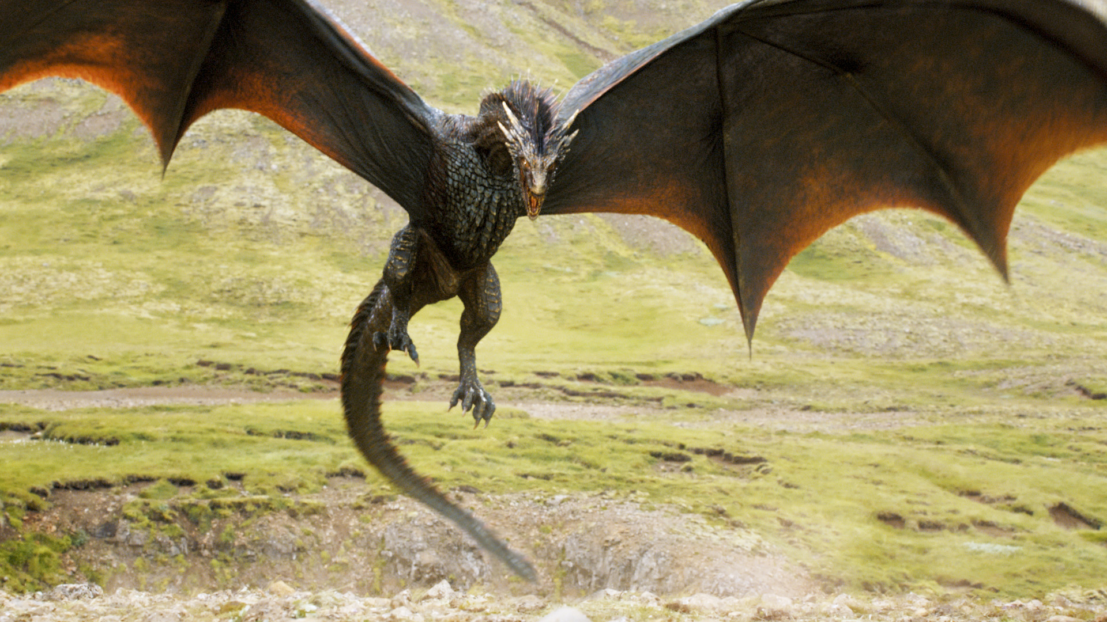
https://warriorcchsmath.weebly.com/orientation.html
As the process of teaching math is continuously in flux so is the expectations of what the students arriving to
High School will have a working knowledge of;
example the Math Practices.
As mentioned earlier – this lost generation may not have any concept what we are asking of them so another data input would be the SMP survey!
Notes:
Orientation
SMP survey – data from google – have them take this
Learning Styles
Student mindset

Slide 9
Math Journal
Label: My Math Journal- Your Name
What are you learning today?
Why are we learning this? How are you going to learn it? How will you know that you got it? Where can you get help if you
don’t get it? What evidence do you have that you
learned something today?
We have discovered that data can be found in a myriad of places; from a simple question to a student, all the way to the ‘big’ assessment. One way that we have found that works really well for us is the Math Journal.

Slide 10
Another idea we had was that kids need to understand how they learn!
Personally I need some kind of noise, be it music or just the TV on, and I find that multitasking helps keep me focused.
Students don’t really think about that that much so we have them do a quick ‘assessment’ of their preferences so they can figure out how to do their work in the best possible environment.
https://warriorcchsmath.weebly.com/orientation.html

Slide 12
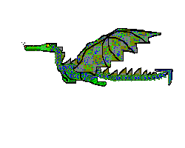
Another way to assess them is with games:
Examples could be a
Desmos Polygraph
GIZMOS
Cue THINK!
Or KAHOOT!
So please download Kahoot!
https://kahoot.it/challenge/0161393
with Game PIN:
0161393
Notes:
Show this from boaler – see the changes that the kids have to do

Slide 13
And as always we have the
ubiquitous
Google Form!
I really like these for the ease of creating them and
the instant feedback that I can provide.
https://docs.google.com/forms/d/1LXDFQeoKApRo2OHBp6Cs0xWRdVYMvk3uVQxYf6Yud30/edit

Slide 14
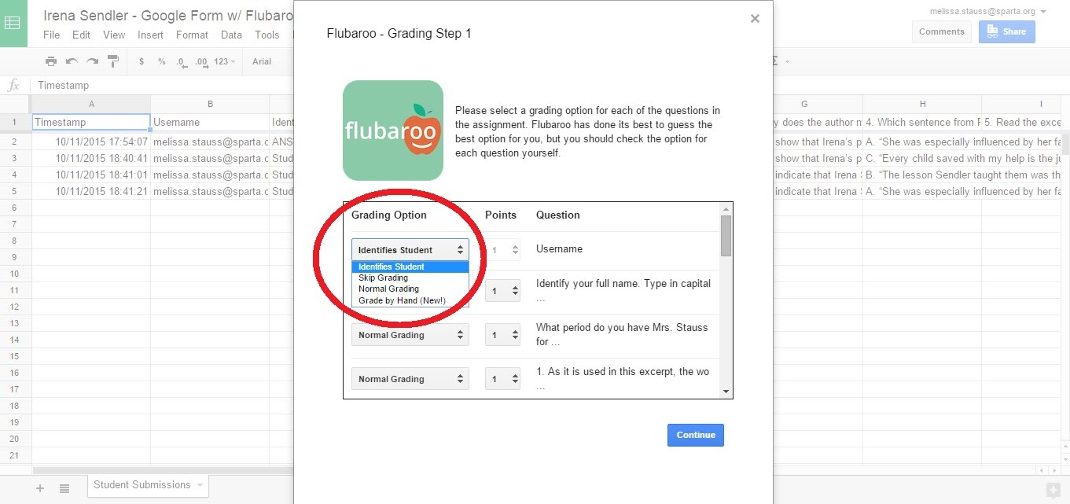
And of course from there we can go into
Flubaroo which sends the results
directly to the students!
There needs to be the direct access to
feedback for the students or why do we do data!

Slide 16
So in conclusion –
lets make our students
take ownership of their data
and become the
Dragon Slayers of the Future!

Slide 17
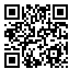
Karin Lee
Dr. Jordan Smith
Thanks for coming!
http://bit.do/eeT4d
Please send feedback through the
above bit.do or by the Q-code

