Slide 1
Seeing the Future through the Dashboard Lights
Dr. Jordan B. Smith Jr.
Ms. Karin Lee
San Jacinto Unified School District
Mountain View Alternative Schools

Slide 2
Description of Presentation
Like it or not the California Accountability Dashboard is here to stay and a continuation school staff must plan to monitor instruction and learning outcomes. Students and teachers are discovering strategies to overcome the fear of taking the 11th-grade summative assessment. We will share our strategies for preparing credit deficient students for the CAASPP using the SBAC digital resources incorporating expository writing, formative assessment, and technology to master essential standards for college and career readiness.

Slide 3


Slide 4
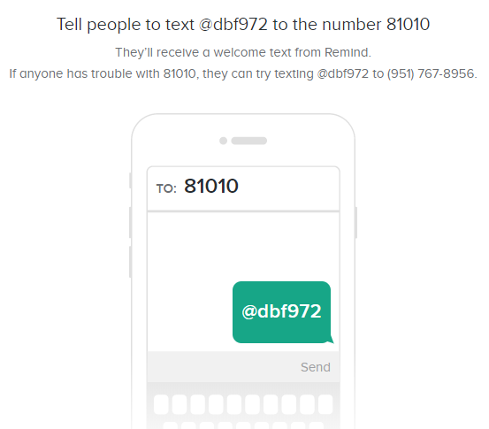

Slide 5
Once upon a time
https://www.remind.com/join/dbf972
Notes:
In 1972 I entered the United States Naval Academy. I graduated in 1976 with letter of commendations. I achieved the rank of Captain (skipper) early. But forces at work against me would have me tumble and fall because I was passed over for the rank of Lt. Col and was force to leave at the rank of Major. Ironically with no retirement due but social security. The Marine Corps was my life. In 1996 I had to choose a different past from the United States Marine Corps. I struggled for 8 years being a web designer, webmaster, bartender, DJ, bar manager and karaoke host.
On Valentine Day in 2003 I met the love of my life Joyce who asked nothing of myself. She believed in me and accepted me for who I was at the time. I was very lucky. I was broke with no money in any bank. I had a 12 year old red jeep in need of repair and a paint job. I was on unemployment of $486 every two weeks. I had really bad credit. She on the other hand was a single mom who owned her home, owned a nice car and had a steady job supporting two adult kids and one grandson. What I did not know at the time was that I was about to marry Santa Claus. I mean really she was the only woman that I have ever known to have purchased and wrapped every present before Halloween. I mean you have to dust off the presents to place them under the tree.
I now realize today that I was just like the students who get transferred and report to our school each and every week. My wife was my counsellor that rebuilt a broken ship. In 2012 MV Alternative Schools had 112 graduates, last year in 2018 we had 278 graduates and this school year we have exceeded our monthly graduating totals 8 out of nine months.
So why am I sharing this story with you right now? I know that something is more important for us to straighten up and fly right. For 15 years ago i became a teacher to make a direct impact on student learning and now I realize that I am living that dream but the vision is still out of focus.

Slide 6
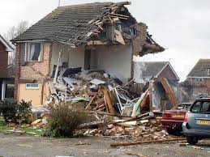
This was my Life
Notes:
See this was my life when Joyce met me in 2003!

Slide 7
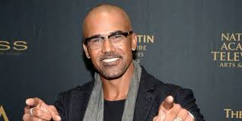
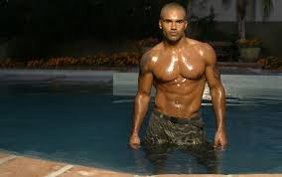
But she saw this!

Slide 8
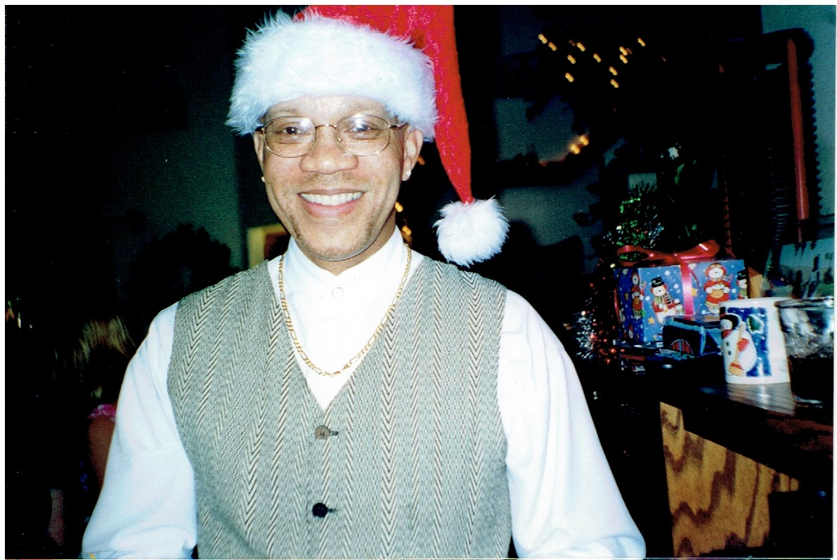
It Was Really This
Notes:
See this was my life when Joyce met me in 2003!

Slide 9
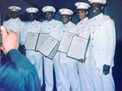
But She She Never Knew

Slide 10
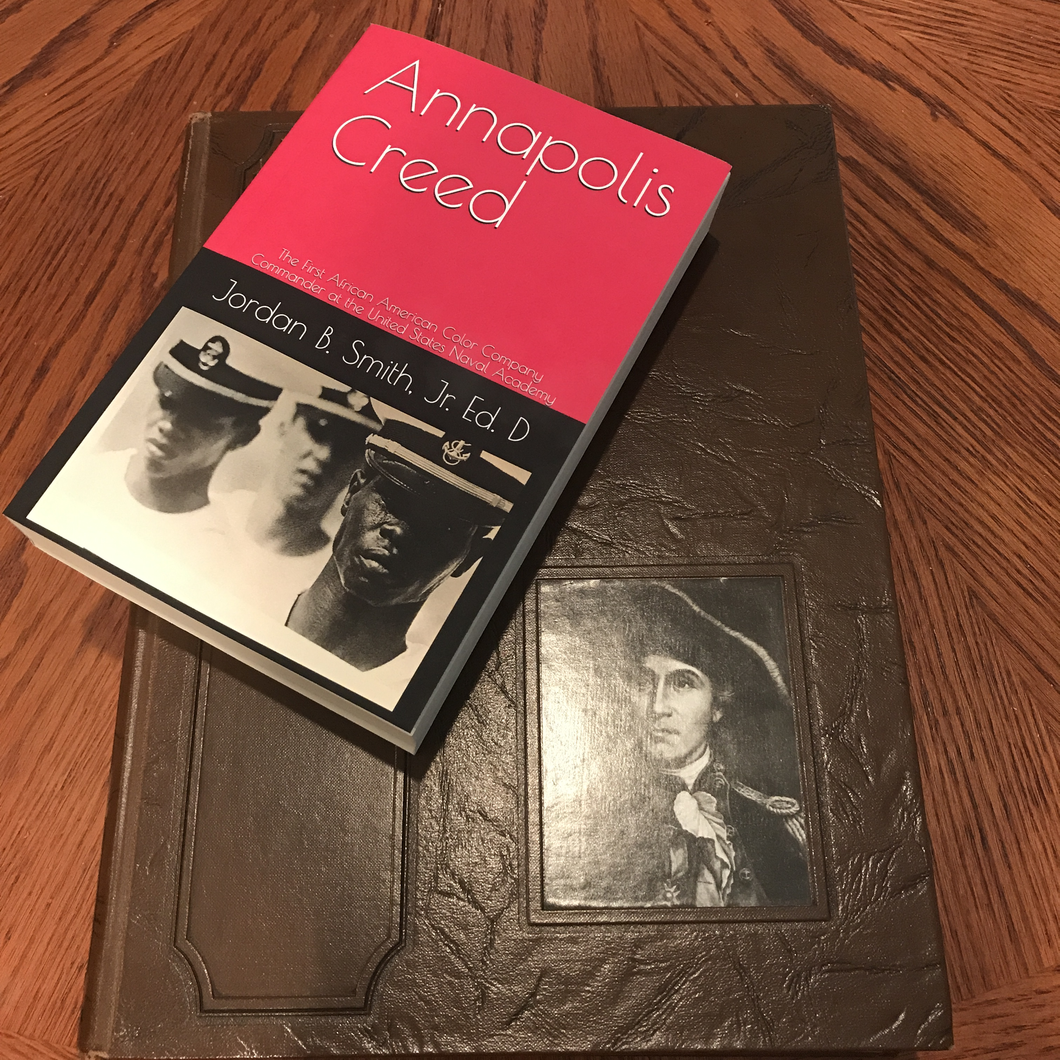
That 28 Years Ago I was Annapolis Creed

Slide 11
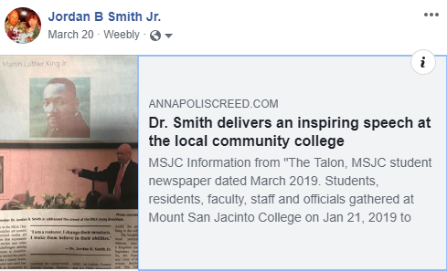
In 15 years She had Built This!

Slide 12
So Why am I sharing this story with you right now?
Everyone Needs a Why
Notes:
I am sharing this because I want you to remember the “Why”!
CCEA is very important and I was struggling to put this presentation together. It was only after completion of the visitation that it hit me that I needed this experience to complete this presentation. Because without the why nothing will ever get done. On Tuesday of this week I was conducting a Mid-Cycle WASC visitation of a school who began a personalized learning academy which had an enrollment of 120 students but due to administrative decisions and an economic turndown the school enrollment drops down to 30 and then to 8 students. They went from 8 to 2 teachers. They began the school year with 31 students and now their enrollment is at 93 and expected to grow next year. The interviews with the students provided evidence as to why the school was growing.
Take a moment and share with someone next to you as to what the students said about the school?

Slide 13
This Week is Our Spring Break
On Tuesday I was in Oceanside with Vista Visions Academy for a Mid-Cycle Visit
Yesterday I got volunteered by Sharon as a facilitator for a Math Discussion Group
Last night Karin and Myself – Cheered for Renaissance High School becoming a Model School. Never met them but celebrated with them.
And Today I want to Start a Movement!

Slide 14
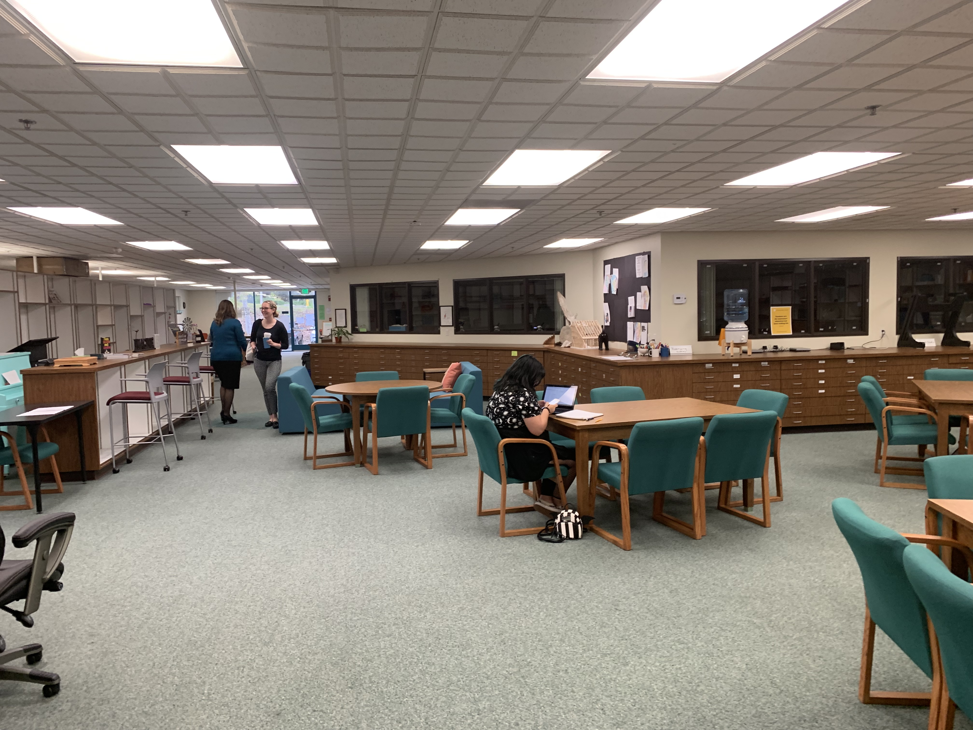

Slide 15
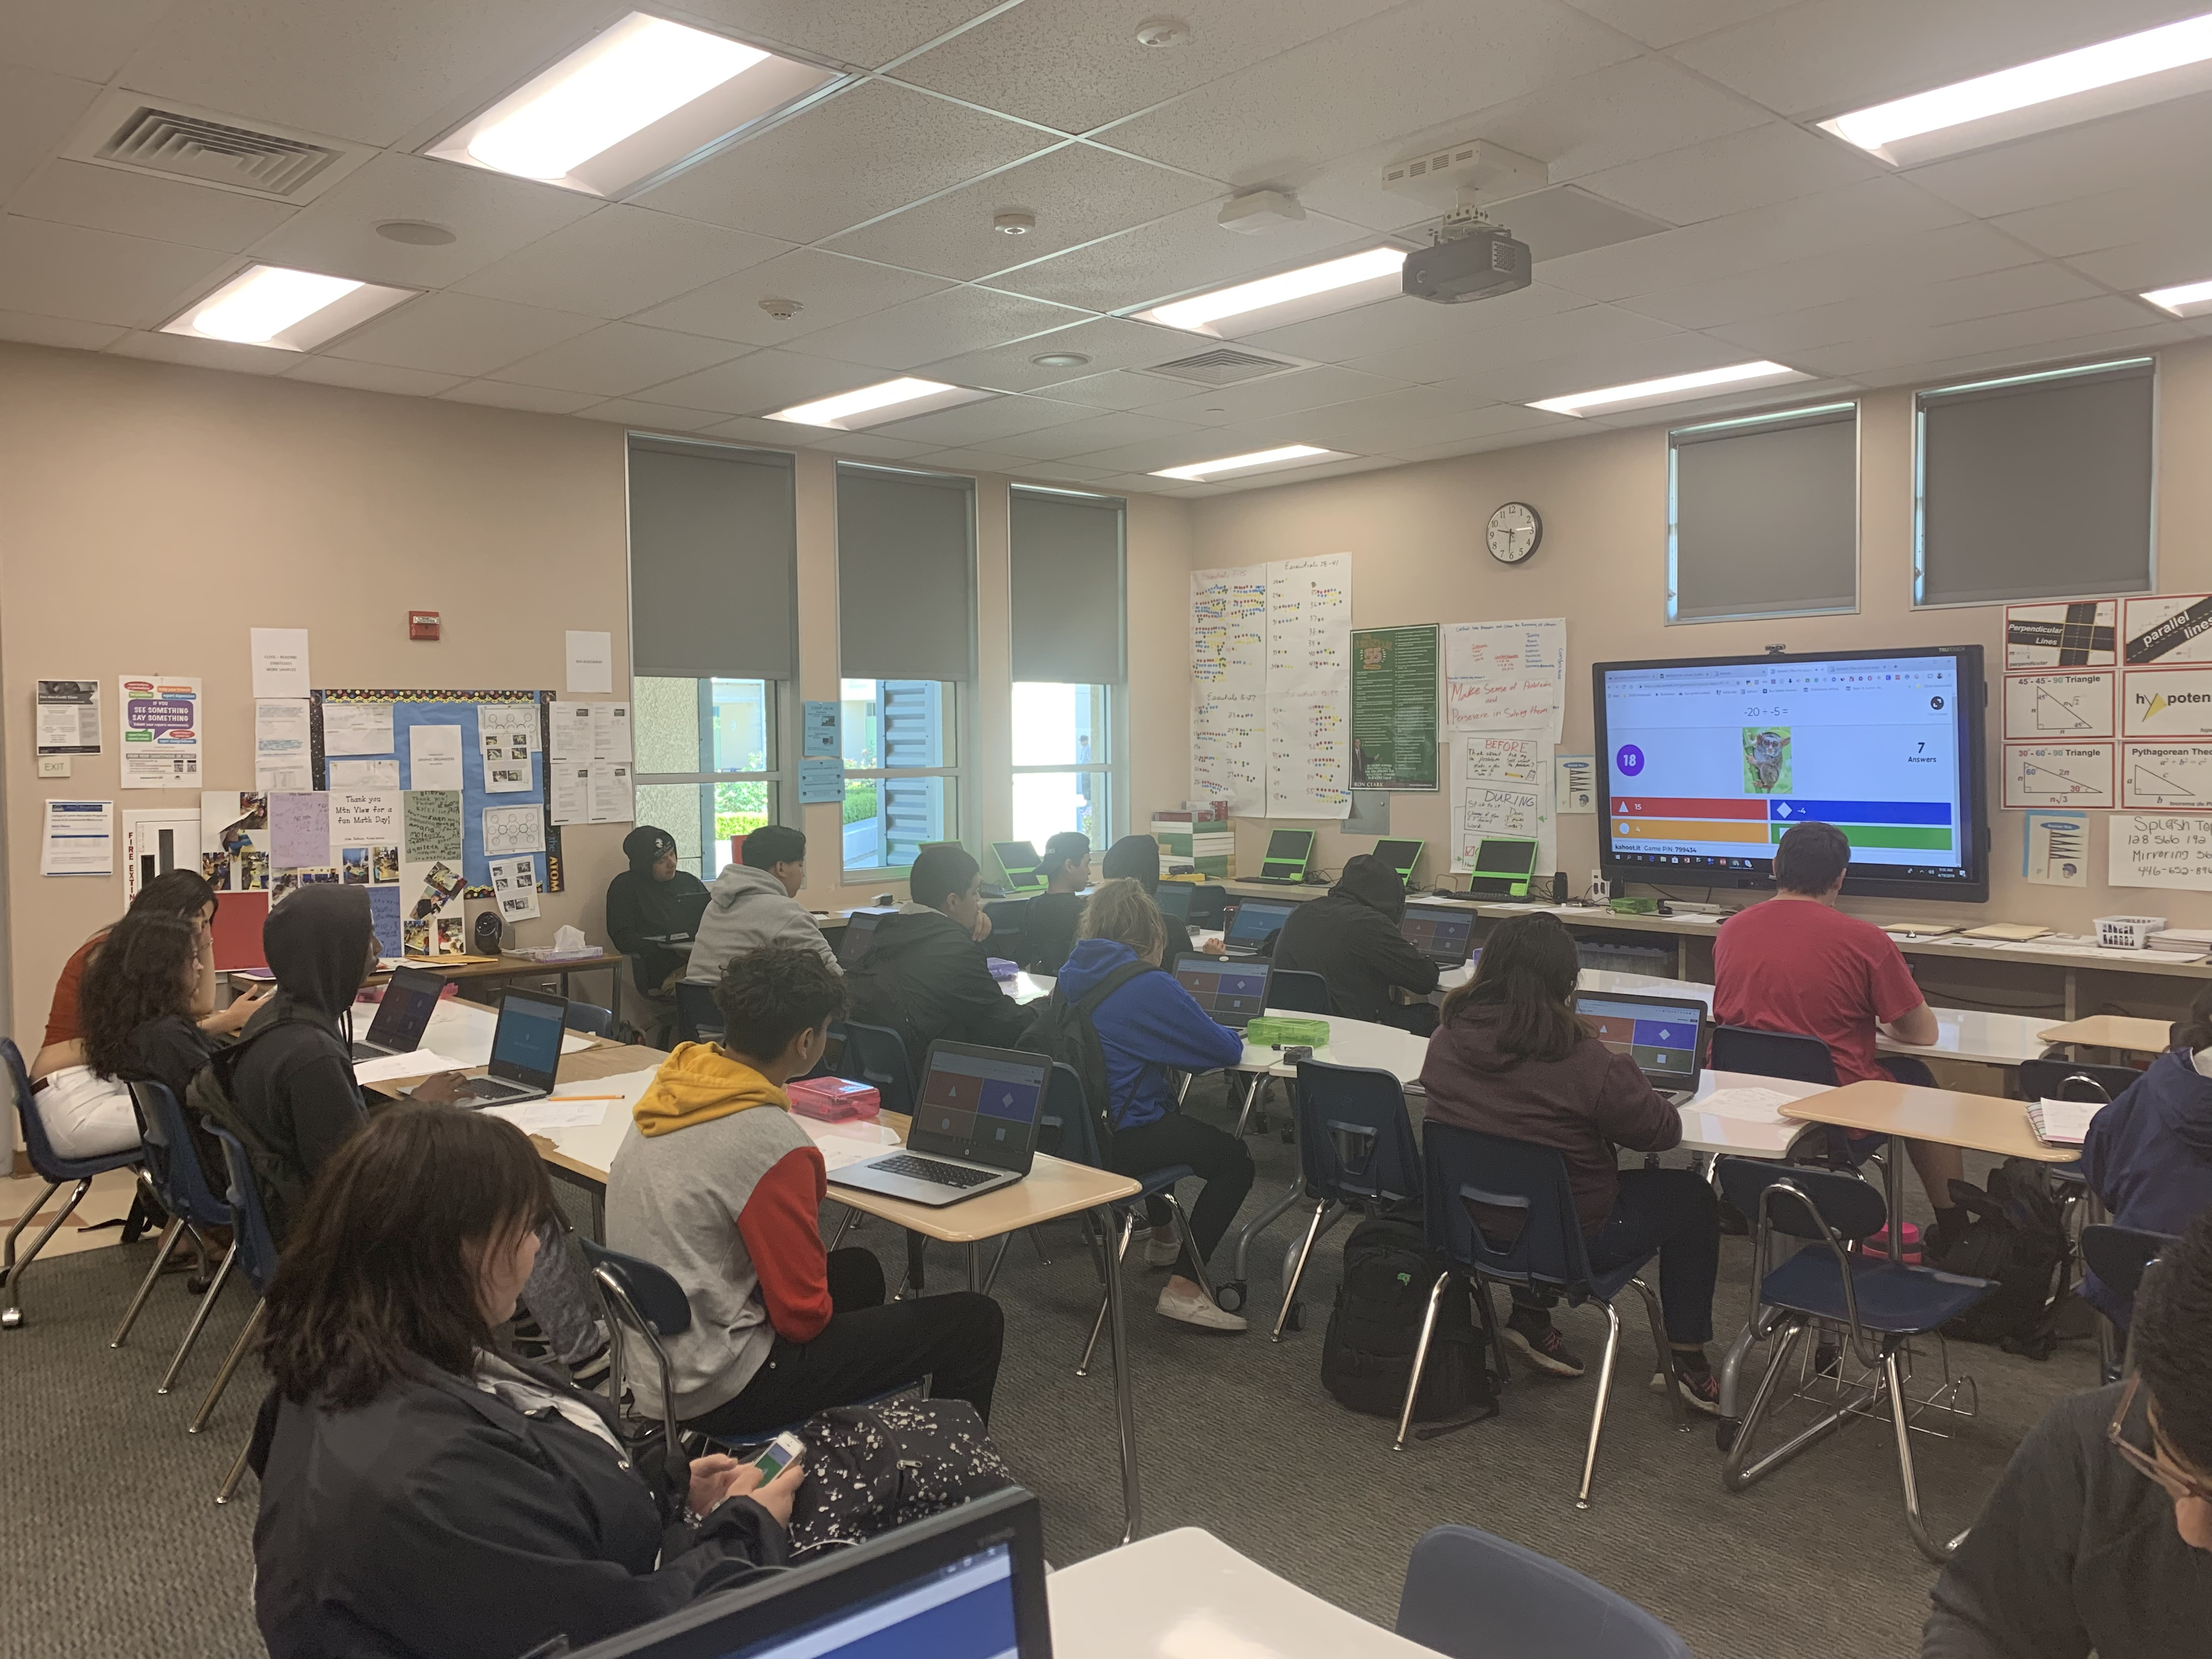

Slide 16
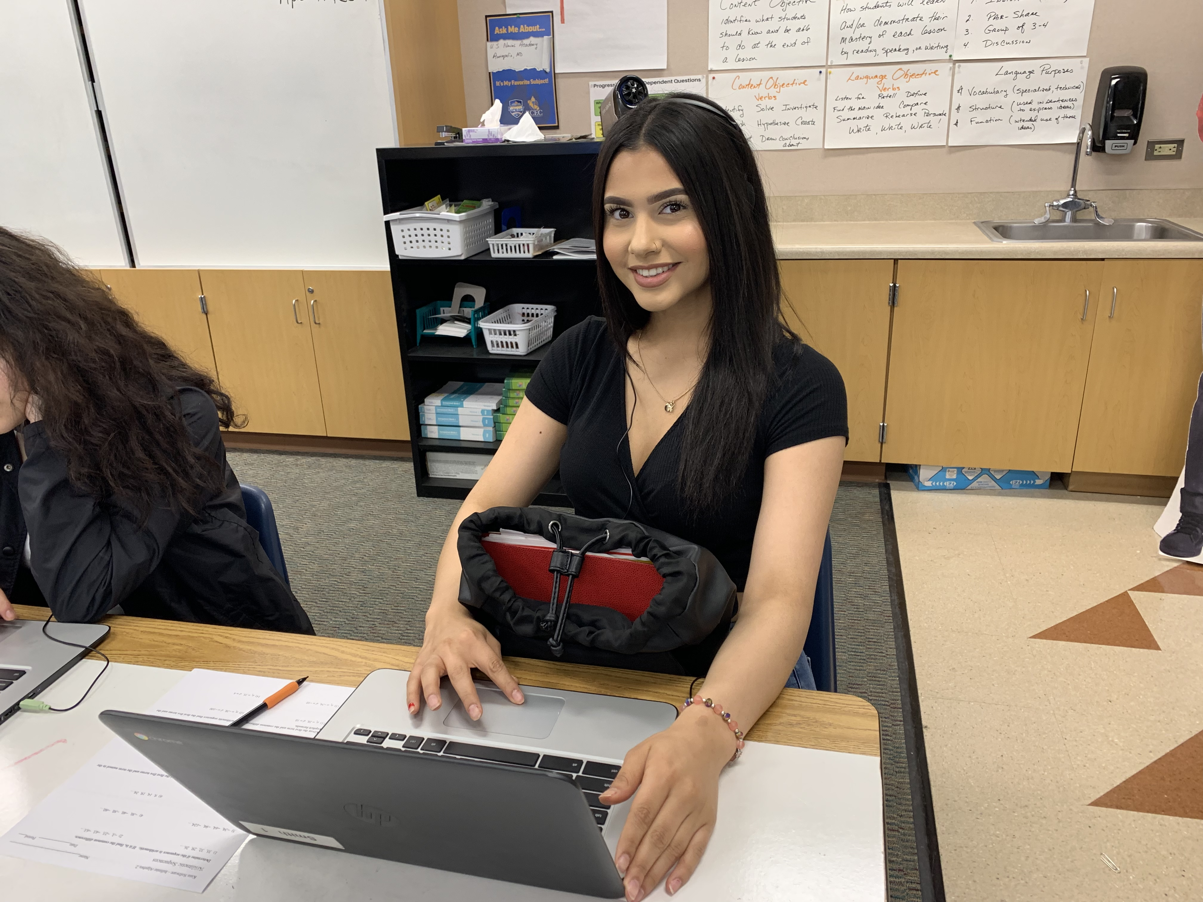

Slide 17
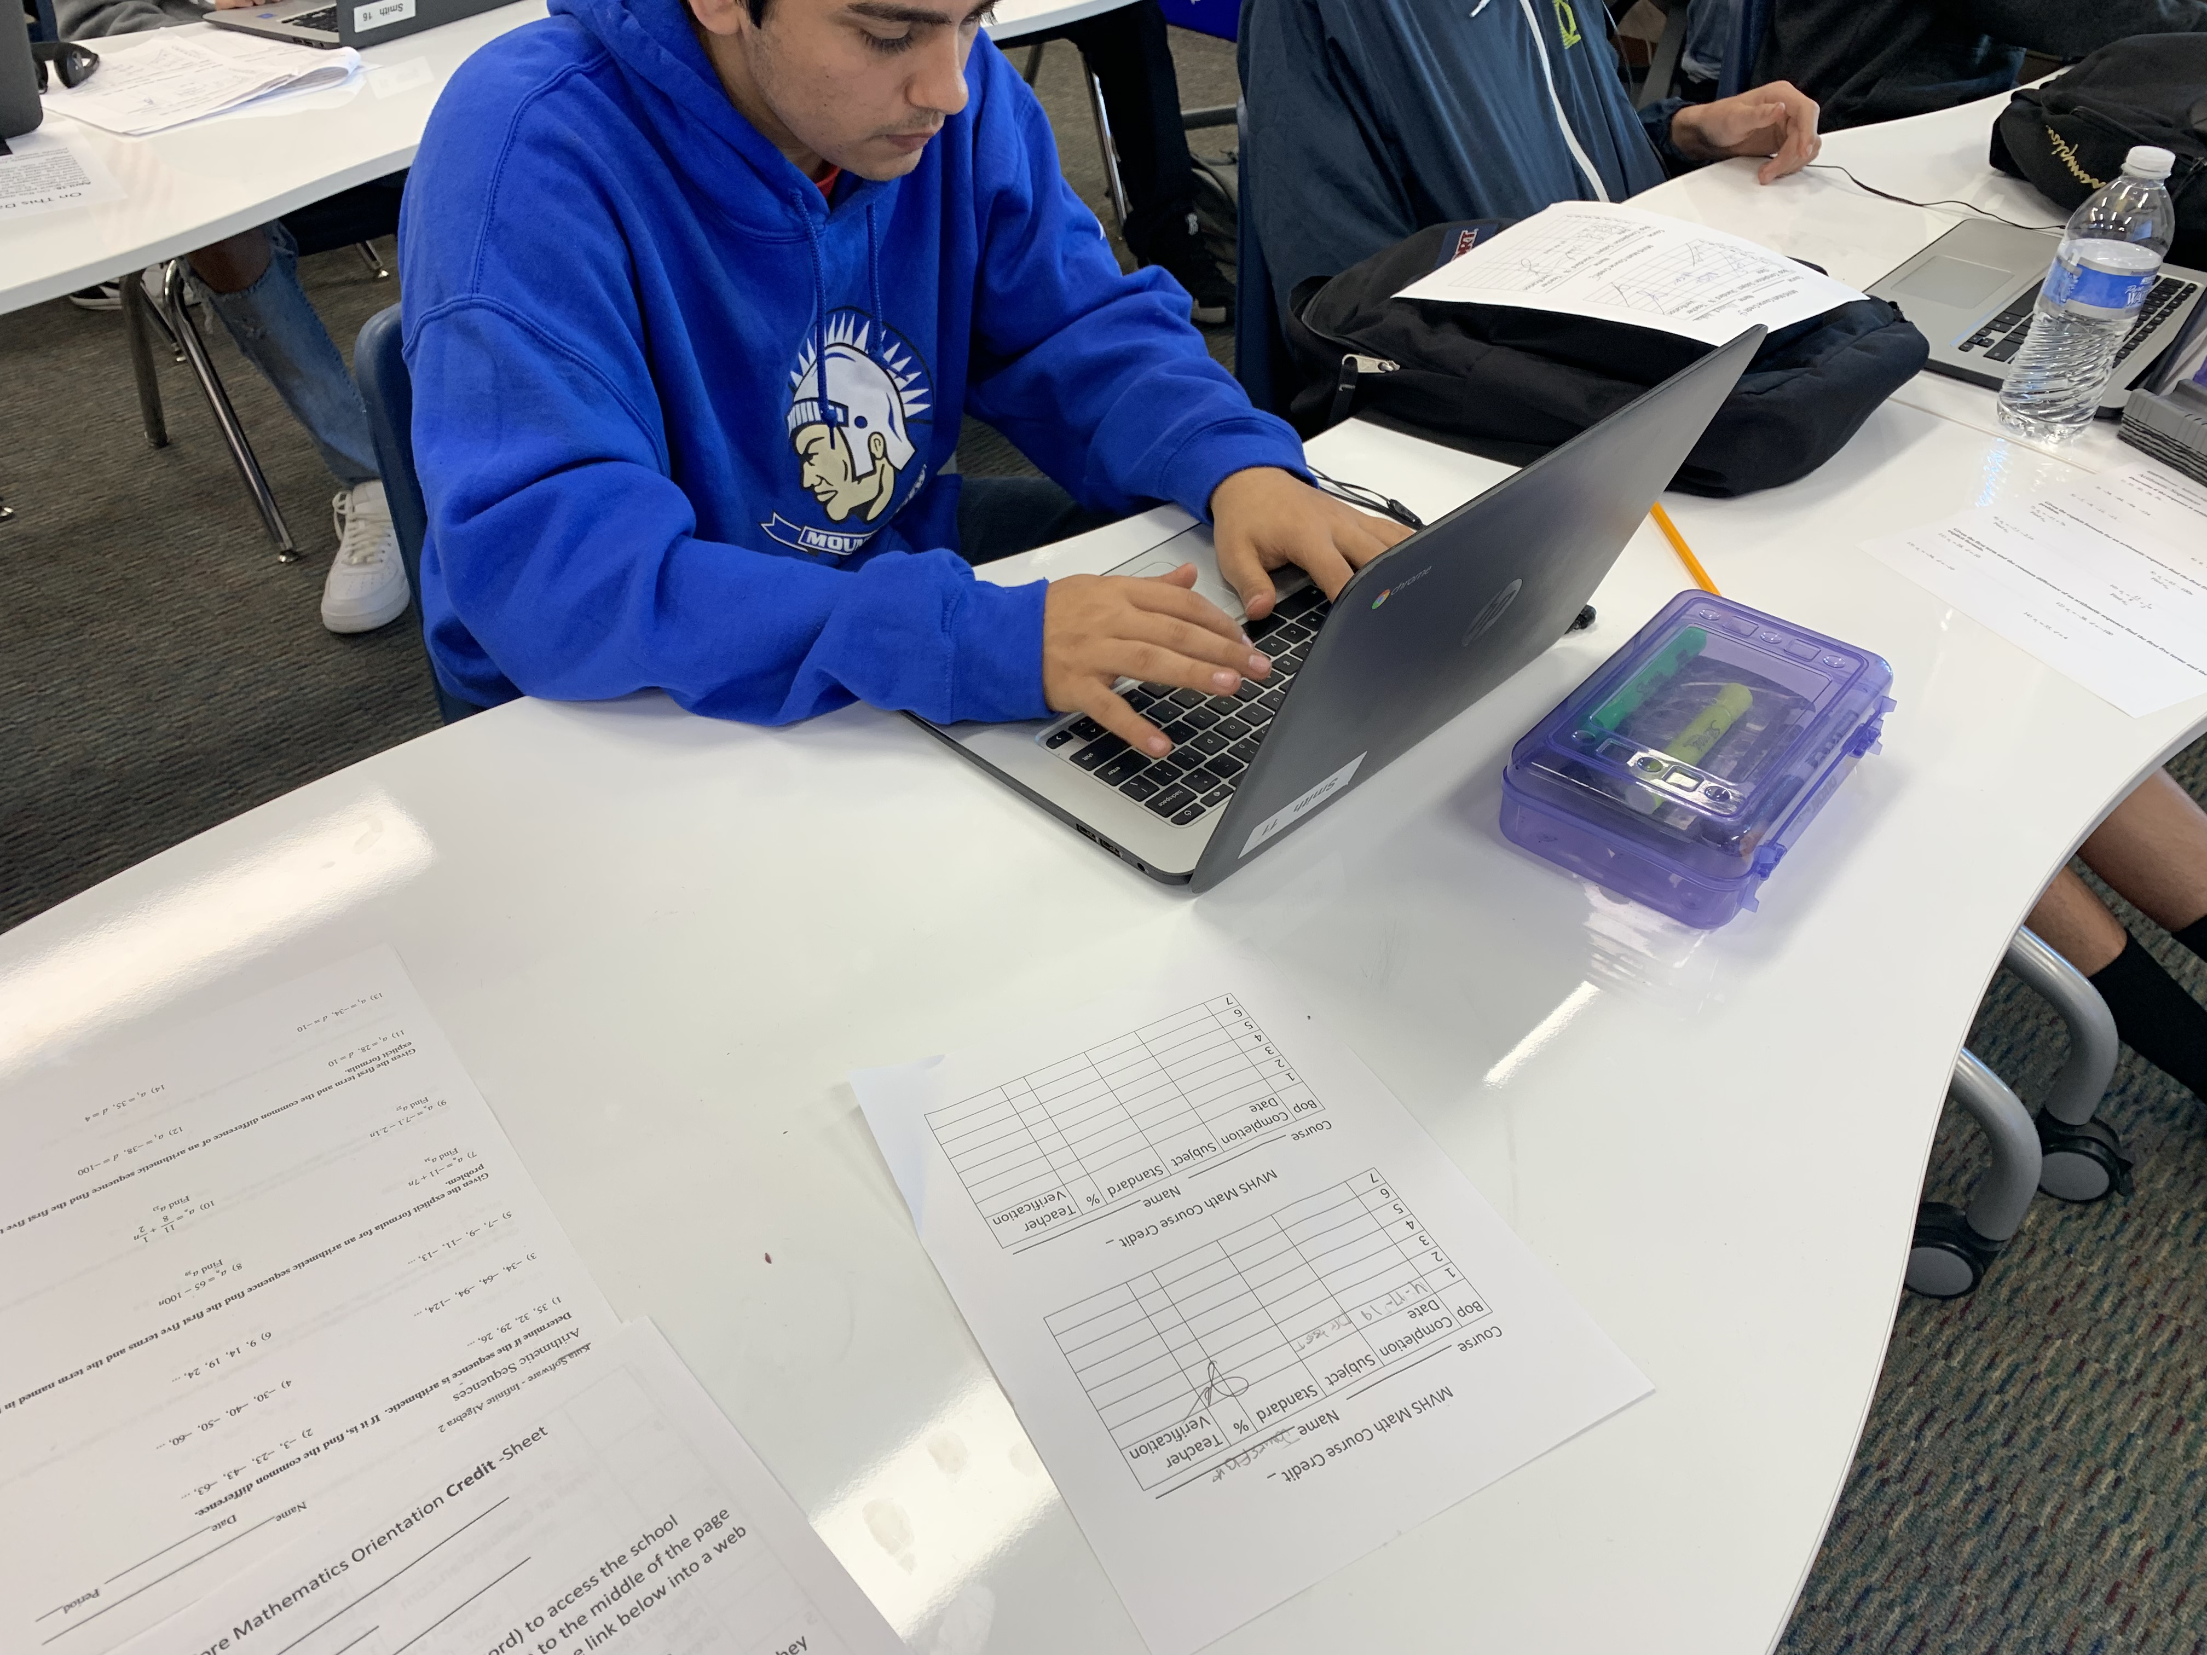

Slide 18
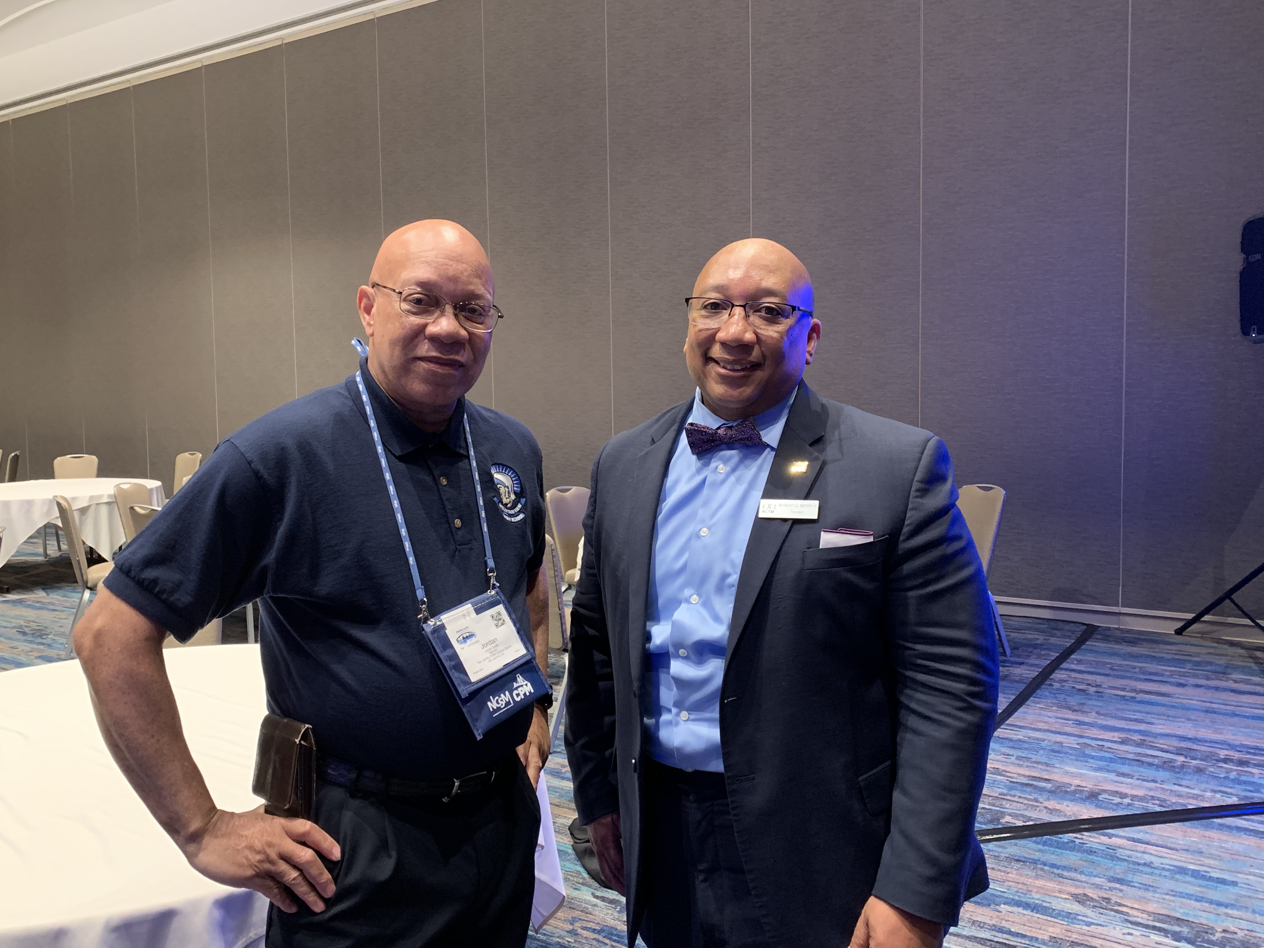

Slide 19
Take a moment and share with someone next to you as to what the students said about their school when WASC came?
They accept me for who I am right now
They provide multiple ways for me to learn
They are accessible online after school hours for help
They are my counsellor and mentor
They Care!
Notes:
CCEA is very important and I was struggling to put this presentation together. It was only after completion of the visitation that it hit me that I needed this experience to complete this presentation. Because without the why nothing will ever get done. On Tuesday of this week I was conducting a Mid-Cycle WASC visitation of a school who began a personalized learning academy which had an enrollment of 120 students but due to administrative decisions and an economic turndown the school enrollment drops down to 30 and then to 8 students. They went from 8 to 2 teachers. They began the school year with 31 students and now their enrollment is at 93 and expected to grow next year. The interviews with the students provided evidence as to why the school was growing.
Take a moment and share with someone next to you as to what the students said about the school?

Slide 20
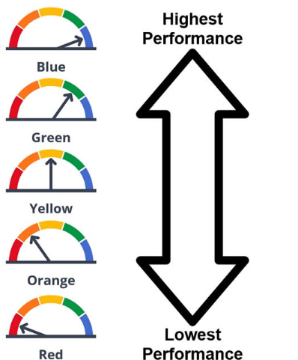
Notes:
Our biggest fear and disappointment was that the alternative assessment dashboard was to be different. We thought it was going to address the issues of students coming to us as 10th and 11th graders and having to take an 11th grade assessment. Clearly we could not be graded the same. In the fall of 2018 the results were devastating. So what’s more important? Students graduating during their 4th year of high school or the accountability dashboard?

Slide 21
What’s Are Your Priorities?
In the fall of 2018 the results were devastating for most CCEA schools. So what’s more important?
Students graduating during their 4th year of high school or the accountability academic performance on a standardized test.
Survey Click Here Go To https://tinyurl.com/y6lpux8n
Do on Remind App Later

Slide 22
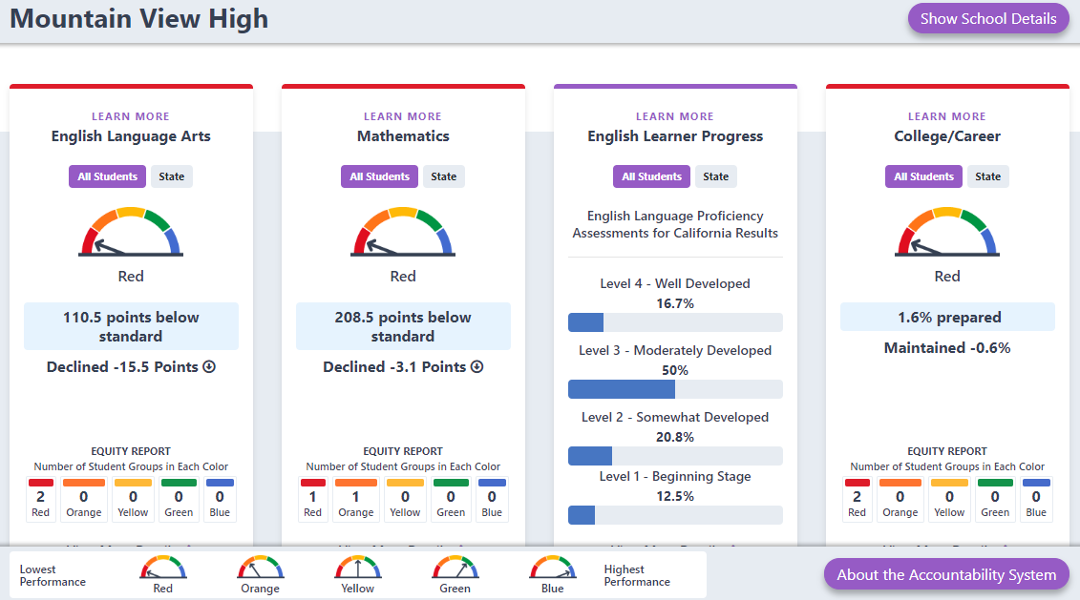

Slide 23
What do you notice and wonder?
ELA is in the Red
Math is in the Red
Excuses?
11th graders arrive with few credits in ELA & Math
11th graders arrive with deficient skills in ELA & Math
How do you teach 3 years of Math or ELA in 11 months?
Can we prepare for the SBAC and Graduate them on Time?
What do we sacrifice?

Slide 24
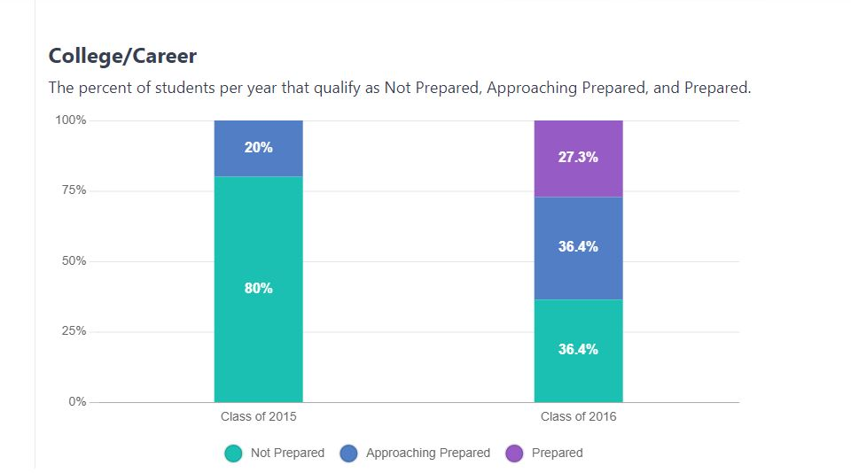
What did you notice and wonder?

Slide 25
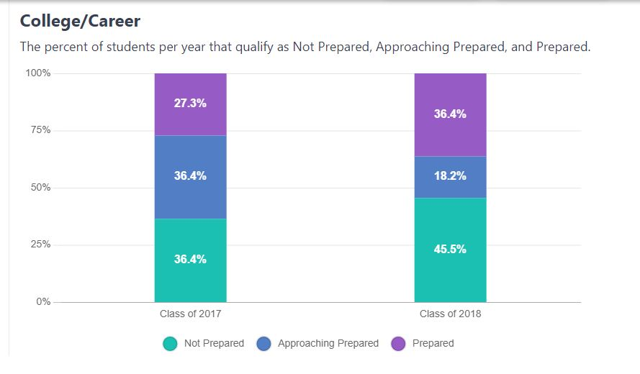
What did you notice and wonder?
How About An Unusual Approach?
ALL MEANS ALL
There has to be a solution. Right?
Is the dashboard going to go away? Yes or No?
Can anyone close the achievement gap? Is it possible?
Do you as a teacher have a fixed or growth mindset about your students?

Slide 26

Distance From Standard and The
California Dashboard

Slide 27
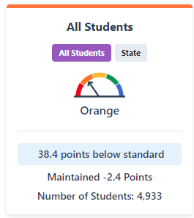
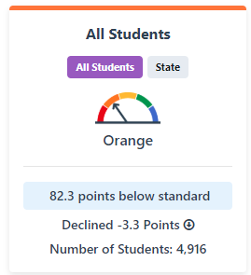
Dashboard - Academic Indicator
All Students
Explore how well students are meeting grade-level standards on the English Language Arts and Mathematic assessments. This measure is based on student performance on the Smarter Balanced Summative Assessment, which is taken annually by students in grades 3–8 and grade 11.
English Language Arts
Mathematics
Notes:
If a change is possible we need to focus upon our targets. Is it possible to show an increase?

Slide 28
Distance From Standard - DFS
DFS represents the distance between a student’s score on the SBAC and the Standard Met Achievement Level threshold.
This is also know in our circles as Level 3.
Scale Scores are assigned for each testing Grade. The standard met is considered the lowest score for Standard Met.
DFS reporting is first calculated for each individual student and then aggregated into a school or district overall score.

Slide 29
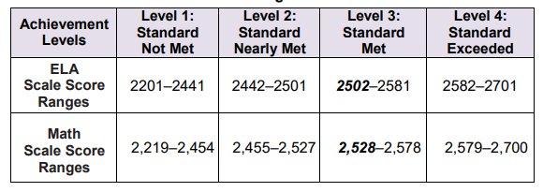
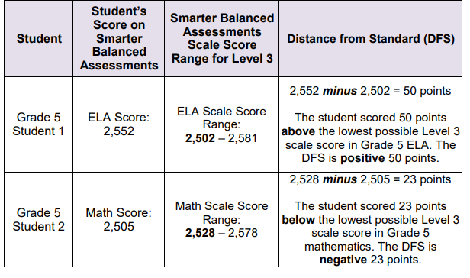
Example: Distance From Standard
Scale Score example
Student scoring example

Slide 30
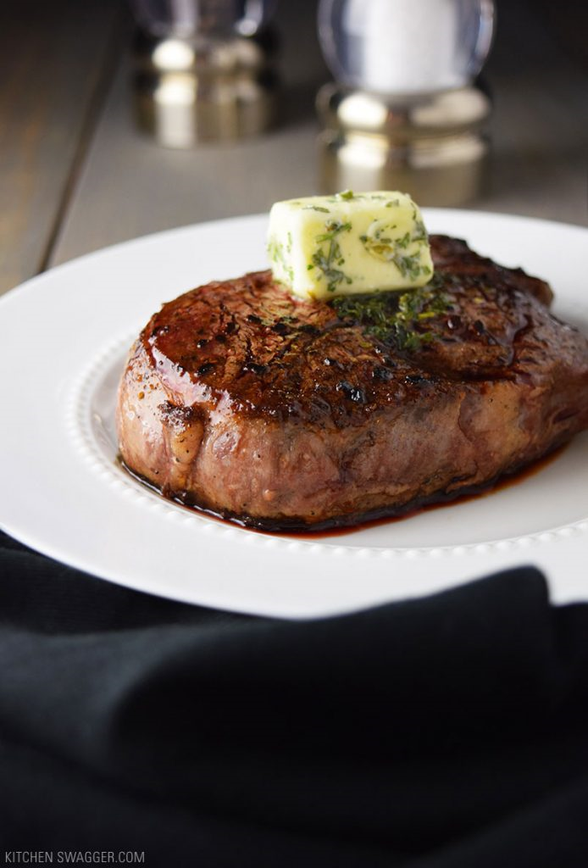
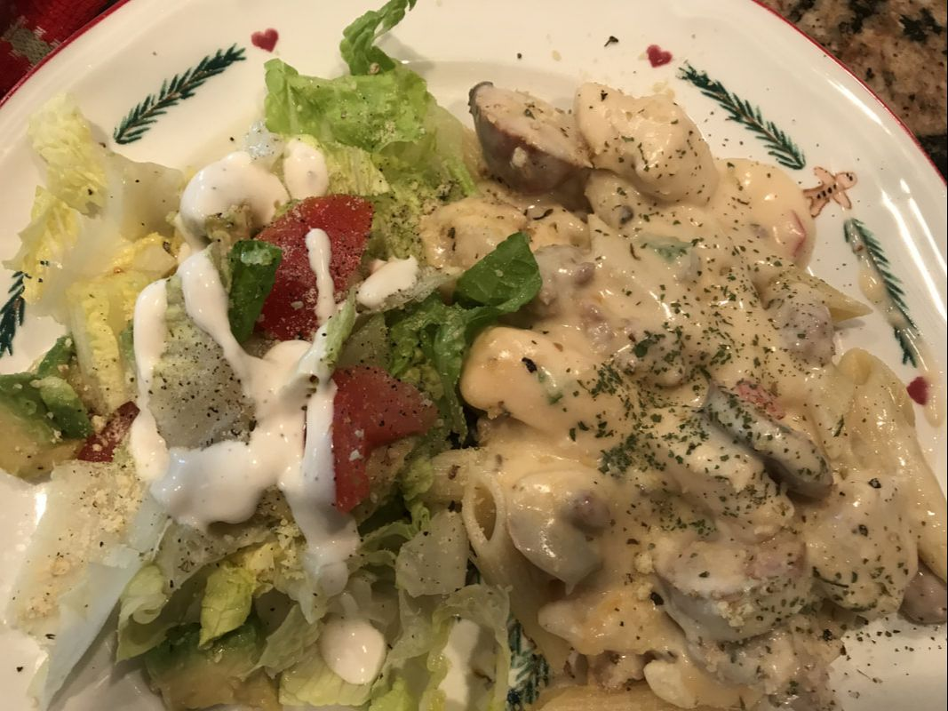
We Need a Good Recipe

Slide 31
A Recipe to Make Improvements
Notes:
These approaches for making improvements come from more than one school. As A WASC visiting committee member and chairperson during the past four years I have collected data about what is making significant changes in learning outcomes and I want to share those strategies with you today.

Slide 32
Key Ingredients-Beyond the Content
Orientation (On-boarding) Growth Mindset Fixed Mindset Learning Styles Diagnostic Testing Embedded Expository Writing Close Reading Strategies Performance Task Solving Strategies Universal Design Tools Student Feedback Formative Assessments Practice and Training Tests School Calendar Problem-Based Learning | ICA/IPT Testing IAB for Correcting Deficiencies Digital Library Resources PLC Time on the Calendar Data Analysis & Review Curriculum Design - Focus on Intentional Targets Multiple Learning Platforms Multiple Assessment Options Demonstrate Proficiency Desmos TI Calculators Benchmarks
Wonder & Notice - Share with a partner

Slide 33
Directions for Cooking the CAASPP SBAC Results

Slide 34
Derive Your Essential Concepts
Keep it A-G teach all the standards
Make a Decision about What are Essential Learning Take-Aways
Assess student mastery (80% or higher) of Essential Concepts
Use Current Research - NCTM (2018) Like “Catalyzing Change for High School”
Maintain rigor of mastery level for essential standards
Use Project Based Learning Tasks - Cross Curricula Tasks (9 Week- Multi-Course)

Slide 35
Orientation
Every student requires on-boarding and an orientation to the learning materials
Textbook - You must teach them everything about the text book - Don’t Assume
Online Curriculum - You Must teach them how to use it. That means you have to do it first and then share and document the effective learning strategies.
Mindset Inventory - If Fixed - then Youcubed First
Learning Style Inventory - You and the Student Must know their best way for learning. Give feedback using their dominant learning style.
Diagnostic Testing - 100% of students. Set Goal for 11th Graders. Scheduled three times a year

Slide 36
Reading & Writing
Every subject requires and embeds writing task
Augmenative & Expository Minimum for SBAC
Teach Close Reading Strategies and use Daily
Teach Performance Task Solving Strategies
Provide Feedback to Move Learning Forward

Slide 37
Demonstration of Proficiency
Use Multiple Platforms for Learning (Learnbop, Pearson, Edmentum, Edgenuity, etc)
Use student voice in co-creation of assessments
Let students choose topics for research papers
Use multiple ways to demonstrate critical thinking

Slide 38
Technology Integration and Use
ICA/IPT Testing
IAB for Correcting Deficiencies
Digital Library Resources
Practice and Training Tests
Use of Desmos Calculator and Tasks

Slide 39
Schedule on School Calendar
Make PLC Time a Reality – Put It on the School Calendar
Put ICA/IAB on the School Calendar
Put Performance Tasks on the Calendar (3-4 Times a year)
Schedule Diagnostic Testing (3-4 Times a Year)
Schedule Cross-Curricula School Wide Project (9 Week Quarter)

Slide 40
Summer Instititue
I encourage you to attend the ETS and Caaspp
Complete the Interest Form Now!
Setup in Remind!

Slide 41
CAASPP
California Assessment of Student Performance and Progress

Slide 42
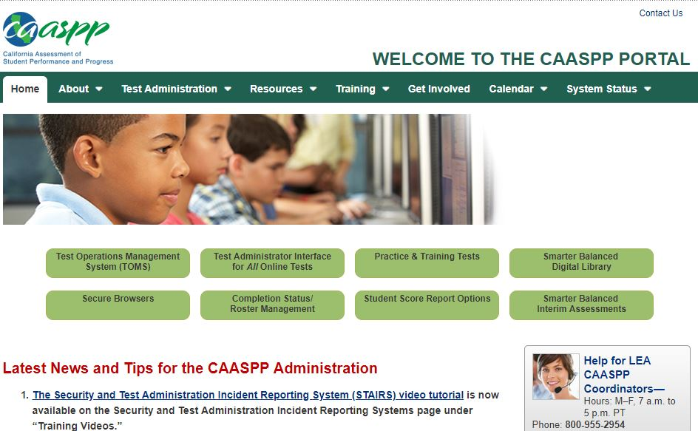

Slide 43
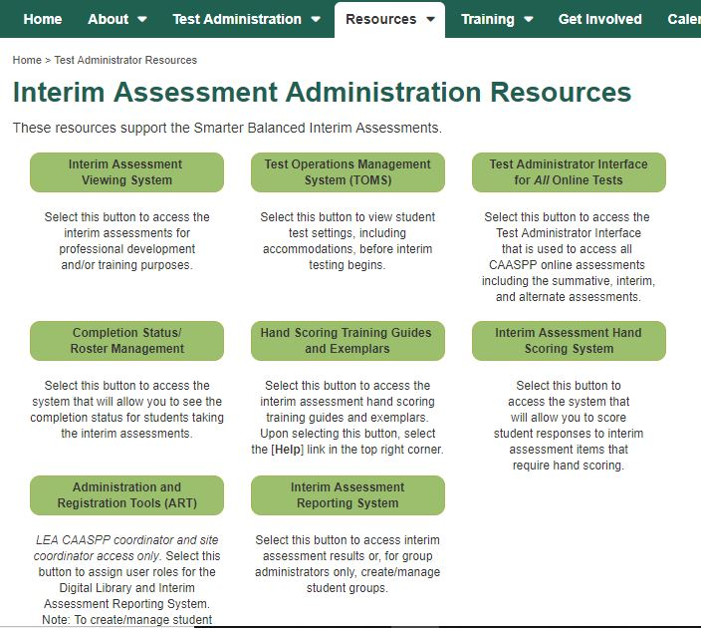

Slide 44
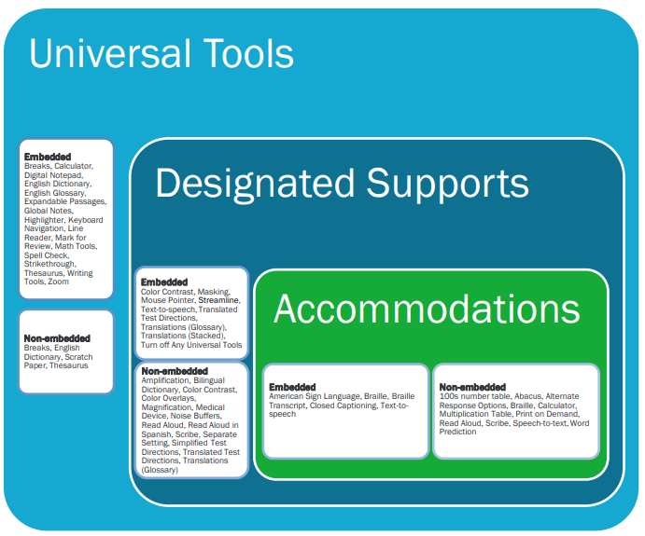
Universal Tools & Designated Supports
Accessibility Resource Sheets: ELA, Math, and Science
Universal Tools, Designated Supports and Accommodations

Slide 45
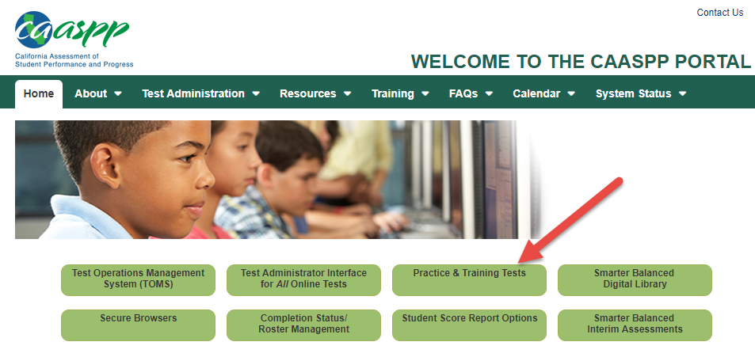
Getting Students Ready for the CAASPP
Embedded Universal Tools, Designated Supports and Accommodations (19 tutorial videos ranging from 1-2 minutes)
Setting up Practice & Training Tests
http://www.caaspp.org
Universal Tools Video HERE
  Great training video for
Students HERE

Slide 46
Digital Library
Click HERE to access the Digital Library
Instructional Resources HERE

Slide 47
ELA Performance Task Practice Tests
Grade Three:
https://portal.smarterbalanced.org/library/en/g3-ela-practice-test-pt-scoring-guide.pdf
Grade Seven:
https://portal.smarterbalanced.org/library/en/g7-ela-practice-test-pt-scoring-guide.pdf
Grade Eight:
https://portal.smarterbalanced.org/library/en/g8-ela-practice-test-pt-scoring-guide.pdf
For each notice:
1. Each grade is the same. It opens with a "scenario" (pretend story) of some sort
2. After THREE articles (only 2 in grade 3, if they're short you may have 4), you will ALWAYS have a chart asking what information shows up in what articles and TWO short answer questions which ask you to take info from all articles and compare/contrast/think about it. In these short answer questions, CITE YOUR SOURCES by either calling them Source 1, etc. or referring to them by title. These may be only one paragraph.
3. You'll have a culminating ACTIVITY at the end. It will always have a "Your Assignment" section made of two paragraphs. The first one will tell you more about the scenario, and the second will specifically give you the assignment. **No matter WHAT KIND OF WRITING (persuasive, explanatory) the activity at the end is a multi-paragraph experience.**
Also in the culminating activity, you'll see an explanation of scoring.
AND, you'll find directions instructing you to PLAN, WRITE, and REVISE the piece. DO ALL THREE.

Slide 48
CAST - California Science Test
Who: Grades 5, 8, 11 & 12
When: May
Click HERE for Science (CAST) Practice Test
Click HERE for Periodic Table used for Grade 8, 11, 12
Click HERE for more information

Slide 49
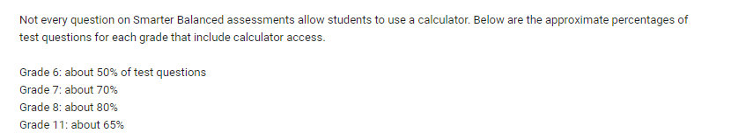
SBAC Calculators
Information about calculators for the SBAC HERE
Click HERE to Explore math with Desmos

Slide 50
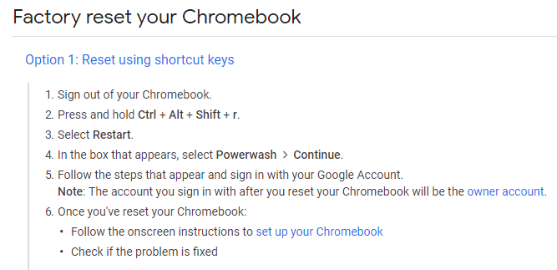
Testing Tips for Chromebooks
Update
  1 Restart (make sure it’s powered down)
  2 Force Update
PowerWash

Slide 51
SBAC Training for Testing Teachers
2019 CAASPP Teacher Training Presentation HERE

Slide 52
SBAC Consortium Claims, Targets, and Standards
Smarter Balanced Assessment Consortium Claims, Targets, and Standard Alignment for Math
Smarter Balanced Assessment Consortium Claims, Targets, and Standard Alignment for ELA

Slide 54
In Summary
We need to Refine and Write a Recipe for Success
All Means All
We Must Believe that we can get out of the Red!
Use the Remind App to Communicate with me!
Go CCEA!
Resources at: www.cchsmathematics.net pwd: smith2019
Thank You for Attending - Questions
https://www.remind.com/join/dbf972 (11:45 Message)

